Slide 1
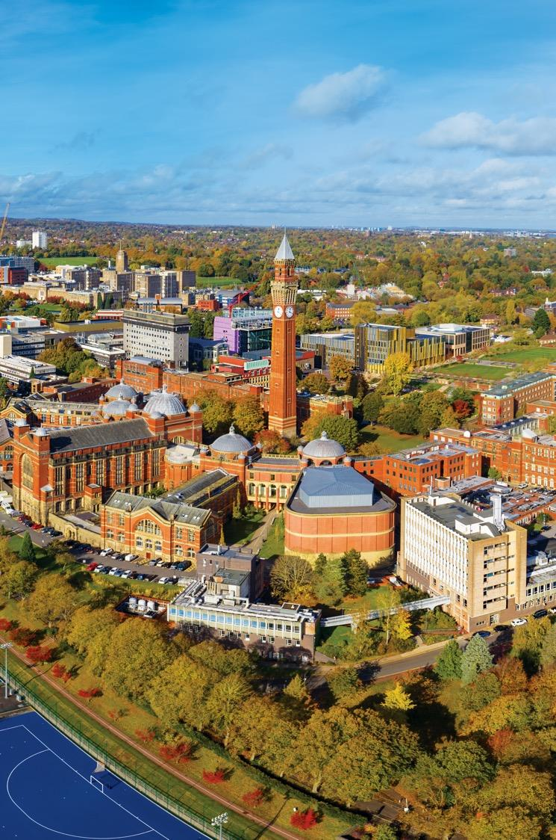

Module: FNP
The Neuro Muscular Junction (NMJ)
Lecture : 3
Dr Ratnadeep Saha
Email: r.saha@bham.ac.uk

Slide 2
You will be able to know
The basic structure of the NMJ and concept of a motor unit
Events underlying chemical transmission & fate of NTs
Concept of MEPP, EPP and quantal transmission
Propagation of electrical potential to muscle and subsequent contraction
Drugs and diseases that affect transmission

Slide 3
The structure of a classical neurone:
Neuron 1
dendrites
Neuron 2
axon hillock
+
axon
+
+
+
dendrites
+
-
-
-
-
dendrites
axon terminal
Neuron 3
dendrites
synapse
cell body
Excitatory
Inhibitory

Slide 4
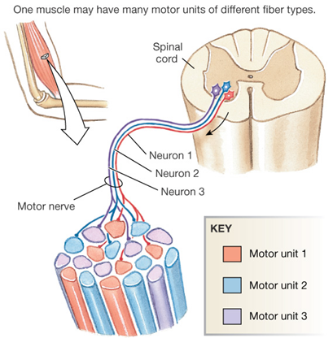
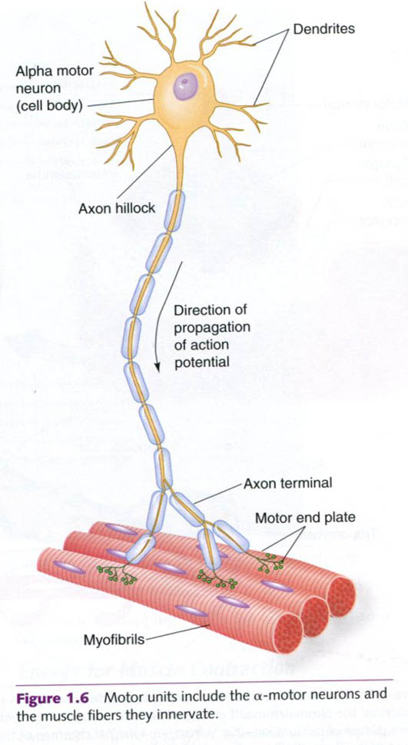
Neuro muscular junction / Motor end plate : Junction between a motor neurone (alpha motor) & the corresponding muscle
Motor Unit : A motor nerve, with its terminal branches keeps close contact with number of muscle fibers. The connections so supplied are called as Motor Units for that neurone.
Notes:
A junction between a motor neurone (alpha motor) and the corresponding muscle is called myo neuronal junction (MEP/NMJ). It is a Specialised form of synapse and best understood one due to its easy access.
Motor Unit: When a single motor nerve, with its terminal branches keeps close contact with a number of muscle fiber it innervates, then the connections so supplied are called as Motor Units for that neurone.
For those muscles which are required for postural activity or strength generation, the number of single nerve innervating concerned muscles is large in number (Hundreds to thousands) whereas for precision movements (muscles needed during writing, eye movements etc) innervation of a single nerve to muscles is few.

Slide 5




Postural activity
Writing
Eye movements
Strength Generation
Single nerve innervating a few muscles are involved in precise activities
Single nerve innervating large gr of muscles are involved in gross activities

Slide 6
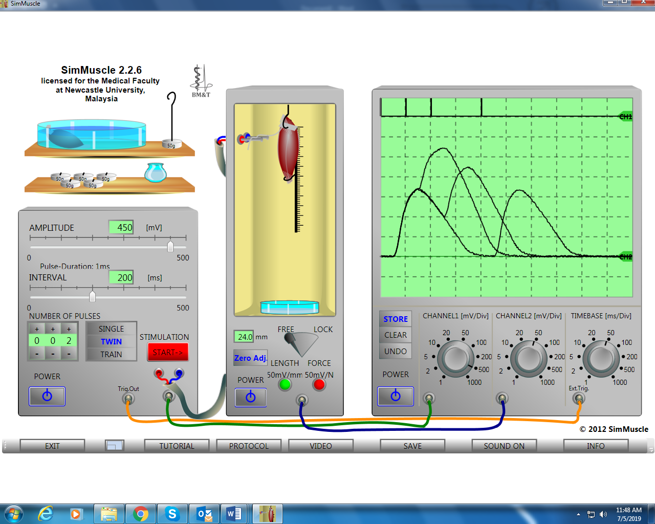
Some relevant aspects : SIM –Muscle practical:

Slide 7
Size Principle (Henneman's principle)
Relationship Between Motor Neuron Diameter and Recruitment Threshold.
Remember: A given muscle has Multiple motor neurone innervation
Motor Neuron Diameter | Recruitment Threshold | Recruitment Order
Small | Low (Easily excited) | FIRST
Medium | Medium | SECOND
Large | High (Harder to excite) | LAST
Muscle
Reasons: Small diameter neurons have:
Higher internal resistance & low surface areas
Lower threshold for depolarization
Therefore, they fire more easily with a given stimulus

Slide 8
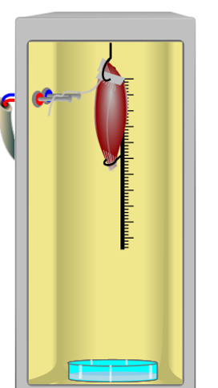
Some relevant aspects : SIM –Muscle practical:
Important information for SIM Muscle : [Sciatic nerve Gastrocnemius muscle]
Fiber Type | Contraction Speed | Fatigue Resistance | Motor Neuron Size | Recruitment Order
Type I (Oxidative) | Slow | Highest (Fatigue-resistant) | Small | First
Type IIa (Oxidative Glycolytic) | Fast | High | Medium | Second
Type IIx (Glycolytic) | Fastest | Lowest (Fatigable) | Large | Last
In gastrocnemius-sciatic nerve muscle set up, the predominant (35-80%) motor neurons are large type (Fast twitch type) compared to small sized motor (20-25%) neurones (Slow twitch type).
When such a set up is stimulated, say with mild stimulus, the Slow twitch types are recruited first.
The large motor size types (Fast twitch) corresponds Type IIa and IIx are recruited later when gradually stimulus becomes stronger.
Notes:
The frog gastrocnemius is a mixed muscle but is predominantly composed of fast-twitch (Type II) fibers (~80%). It contains a small population of slow-twitch (Type I) fibers (~20%)

Slide 9
Back to…
NMJ and its Anatomy

Slide 10
Neuromuscular Junction
Schwann Cell
Mitochondria
Vesicles (5000-10,000 molecules)
Calcium Channel
Acetylcholine receptor
Pre Synaptic area
Post Synaptic area
Synaptic Cleft
Active zones
Junctional folds
Acetylcholinesterase
Notes:
This is typical structure of a NM junction. Please consider any standard physiology book to see the details. You need to know the components mainly (presynaptic area, synaptic cleft area and post synaptic area) and some of their functions. The most relevant and important aspects are mentioned in the consecutive slides.

Slide 11
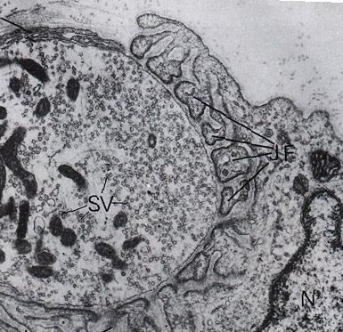
a synapse at a real NMJ
synaptic
cleft

Slide 12
Ach is synthesized from Choline & Acetyl Co A by Choline acetyl transferase (CAT), an enzyme found in neuron
Vesicles contain acetylcholine (Ach), a neurotransmitter molecule, incorporated by Vesicle acetyl choline transporter (Vach T) protein
Releasable pool (20%)
Low Neuron firing frequency
Reserve pool (80%)
High Neuron firing frequency
+ -
+ -
Steps are:
(1) when A.P invades the axon terminal, the presynaptic membrane is depolarised

Slide 13
(2) The depolarisation causes the opening of voltage-gated Ca²⁺ channels
(3) Ca²⁺ rush into the axon terminal
+ -
Ca²⁺
+ -
⊗
Ca²⁺
Ca²⁺

Slide 14
(4) The rise in Ca²⁺ concentration causes the vesicles to fuse with the presynaptic membrane (Role of synaptotagmin: Ca sensor)
(5) Vesicles release Ach molecules into the synaptic cleft (exocytosis)
Ca²⁺
Ca²⁺
Active zones
Calcium binds to synaptotagmin which induces SNARE proteins (Next page)

Slide 15
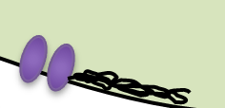
Vesicle Fusion
Synaptobrevin
Active zone
Syntaxin
SNAP25
‘Dense Bars’
SNARE Proteins (Soluble NSF attachment protein receptors)
Notes:
SNARE=Soluble N ethylmaleimide-sensitive fusion protein attachment protein receptor

Slide 16
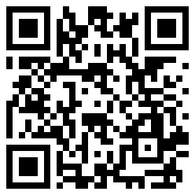
Join the Vevox session
Go to vevox.app
Enter the session ID: 149-856-345
Or scan the QR code

Slide 17
You will be able to know
The basic structure of the synapse / NMJ and concept of a motor unit
Events underlying chemical transmission & fate of NTs
MEPP, EPP and quantal transmission
Initiation of action potential & contraction
Drugs and diseases that affect transmission

Slide 18
Post Synaptic Events

Slide 19
(6) Ach molecules diffuse across the cleft in less than 1 millisecond

Slide 20
(7) Ach molecules bind to receptors in the postsynaptic membrane

Slide 21
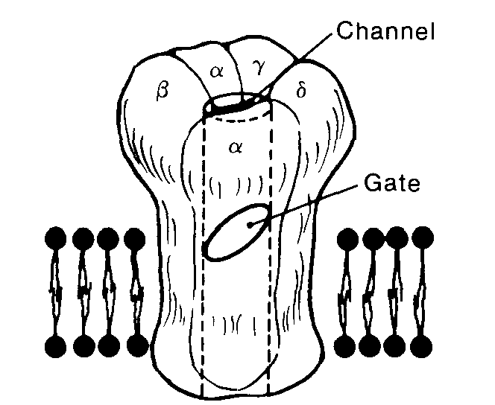
Ach Receptor
Nicotinic receptor
Inner lining is negatively charged
Two alpha subunits are occupied by Ach molecules
Note:
ligand-gated ion channel that is ionotropic (as opposed to metabotropic, which acts via G-proteins → downstream signaling cascades).

Slide 22
(8) The binding of Ach to the receptor causes ion channels to open

Slide 23
The ion channel is called a ligand-gated Na+ channel

Slide 24
What happens when this new Na+ channel opens up?
Na+
Na+
Na+
Na+
Na+

Slide 25
(9) Na+ ions rush into the postsynaptic cell (the muscle endplate)
! but K+ also flow through this channel
Na+
Na+
Na+
Na+
Na+

Slide 26
K+ ions rush out of the postsynaptic cell
K+
K+
K+
K+

Slide 27
What happens to the membrane potential?
K+
Na+

Slide 28
The postsynaptic membrane potential reaches a level halfway between the equilibrium potentials of the 2 ions
E_{Na} + E_{K}
EPP
2
60 + (-90)
= -15 mV
2
EPP = End Plate Potential
So, in net sense potential changes from -70 to -15 mv ie: approximately 55 units.
For easy understanding we assume it to be 40-50 mv units.

Slide 29
The endplate potential (EPP) reaches -15mV
nerve
muscle
(junctional folds)
+30
-15
mV
-70
time (ms)
Notes:
When the EPP reaches to -15 mv to nearby region of myoneuronal junction, it supports the potential to go up further to initiate fully function action potential because of the activation of nearby voltage gated Na channels.

Slide 30
There are no a.p.'s at junctional folds because there are no voltage-gated Na⁺ channels !
But EPP's in the junctional folds trigger a.p.'s nearby, where voltage-gated Na⁺ channels do exist. These Action potential propagate deep within the muscle to activate muscle contraction.

Slide 31
What is the smallest EPP that be generated?
nerve at rest
muscle endplate
+30
-15
mV
mini-EPP (0.5mV)
-70
time (ms)
Notes:
These are the 2 figures showing responses of nerve and muscles at rest. When nerve is not activated at rest, still some small twitches are found in the muscles even though they are very small in magnitude. These smallest EPP or voltage in the muscles even in absence of true nerve stimulation are called as miniature end plate potential (mEPP).

Slide 32
The mini-EPP is the same shape as the EPP, but smaller, and occurs at random, when the nerve and muscle are at rest
nerve at rest
muscle endplate
+30
-15
mV
mini-EPP (0.5mV)
-70
time (ms)
Significance: Maintains muscle integrity or tone; Gives efficiency of muscles in general in our body.
Notes:
Importance: Maintains muscle integrity or tone even when a muscle is not truly active and thus provides efficiency of the muscles in general in our body.

Slide 33
Why does the mini-EPP (mEPP) come in just one size?
As Katz and Miledi discovered in the 1950’s,
  1 mEPP = 1 vesicle fusion = 1 quantum
  = 10,000 Ach molecules
  the quantal nature of transmission: each vesicle releases all or none of its contents
1 EPP (40-50 mv change) = (approx) 100 x mEPP (0.5 mv) amplitude.
So, (approx) 100 vesicles needed for EPP.
But, (approx) 200-300 vesicles released in response to normal a.p. at NMJ.
This extra margin is the safety factor.

Slide 34
What happens to Ach molecules after they bind to the postsynaptic receptor?
If the Ach molecule remained bound to the receptor, the ion channel would stay open, and the a.p. would not be transient
Acetylcholinesterase (Ach-ase), an enzyme on the junctional folds in the synaptic cleft, cleaves Ach
  Ach choline + acetate
⊕
acetyl CoA
re-uptake

Slide 35
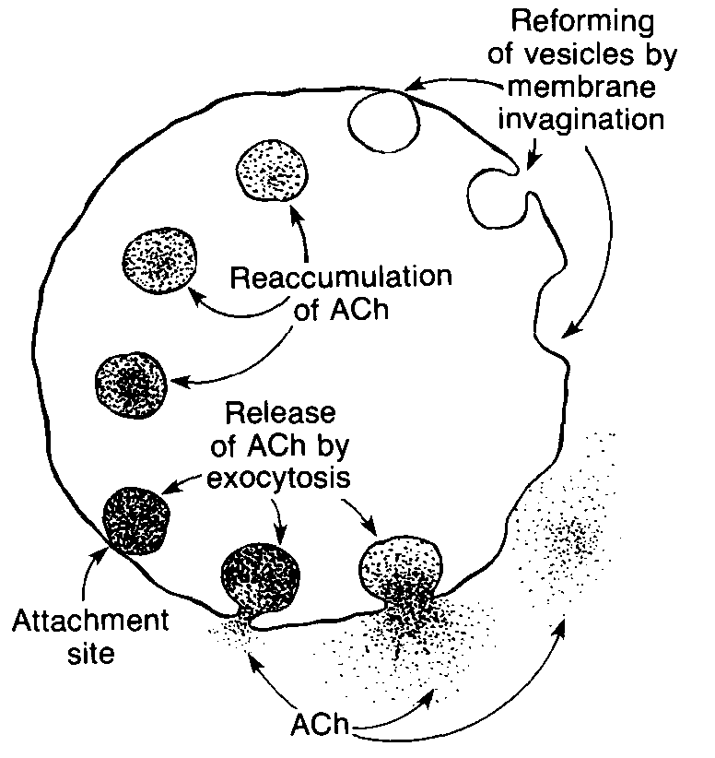
Release and Re synthesis of Ach

Slide 36
Excitation-contraction coupling got the excitation, what about the contraction?

Slide 37
Recap of neurotransmission at the NMJ:
The action potential, an electrical signal, invades the axon terminal
Depolarisation triggers activation of voltage-gated Ca²⁺ channels
Ca²⁺ influx causes the release of Ach molecules, a chemical signal
The Ach molecules open Na⁺ channels in the postsynaptic cell, causing an EPP, an electrical signal
The EPP triggers an a.p, via voltage-gated Na⁺ channels located near the junctional folds

Slide 38
The structure of the muscle membrane
The T-tubule system:
myofibril
T-tubules are invaginations of the muscle membrane (sarcolemma), penetrating deep into the muscle fibre.

Slide 39
The structure of the muscle membrane
The T-tubule system:
What we will see if we make a cross section
terminal cisternae
myofibril
sarcoplasmic reticulum
The sarcoplasmic reticulum (SR) is a tubular structure that surrounds the myofibrils, enlarging into terminal cisternae (TC) near the T-tubules. It stores lots of Ca²⁺

Slide 40
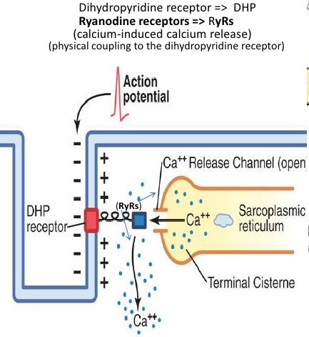
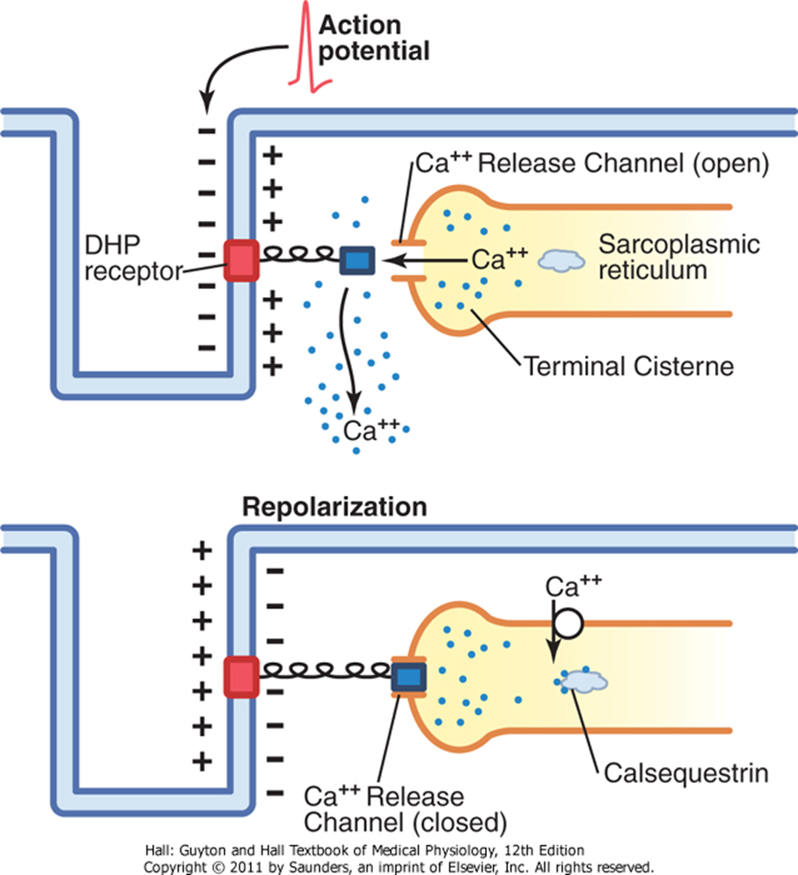
Mechanism of release of Calcium ion
Key: DHP receptors have mechanical linkage with Ca channels via Ryanodine receptors with SR
High capacity low affinity Ca binding ability
Note: Metabolic by-products (H⁺ and lactate) do not have any direct impact to stimulate ryanodine receptors

Slide 41
Role of the Calcium Ion:
Normal Calcium ion concentration ˂ 0.01 µm
Following Action Potential Calcium (Ca) concentration ˃ 0.01 µm
Ca binds to Troponin sites
Conformational change of the troponin
Permits actin- Myosin interaction (Acto-myosin complex)
Muscle contraction begins

Slide 42
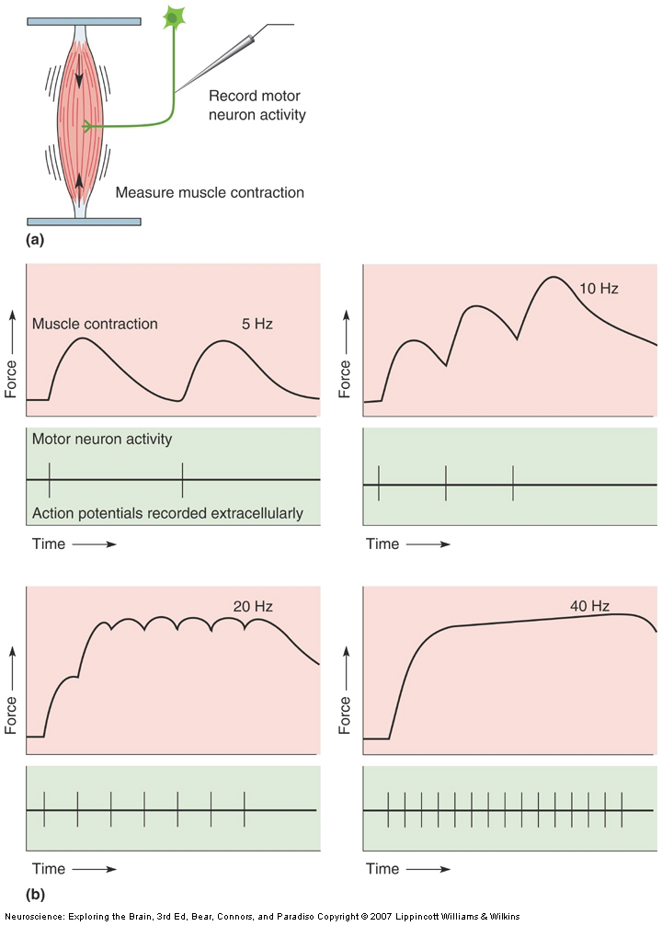
Motor neuron activity leads to muscle contraction
(What could happen if released NTs bound to receptors are not regulated or stimulus appear at frequent intervals?)
Summation / incomplete tetanus (Lower frequency stimulus)
Complete single twitch
Sustained contraction / tetanus (very high frequency stimulus)
Summation / incomplete tetanus (higher frequency stimulus)
All we will experience in SIM-Muscle practical experiment later…
Notes:
Single action potential causes muscle fibre to twitch
Summation of twitches causes sustained contraction as frequency of incoming action potentials increase

Slide 43
You will be able to know
The basic structure of the synapse / NMJ and concept of a motor unit
Events underlying chemical transmission & fate of NTs
MEPP, EPP and quantal transmission
Initiation of action potential & contraction
Drugs and diseases that affect transmission

Slide 44
Drugs and diseases (transmission at NMJ)
Curare:
  blocks Ach receptor, causes paralysis
  used as muscle relaxant by anesthetists
Botulinum toxin (Botulism):
  produced by bacteria in badly tinned foods (Clostridium botulinum)
  inhibits exocytosis so Ach release stopped. Muscles therefore relax
  in severe case paralysis can be fatal
Clinical use:
Inhibition of overactive extra ocular muscles
Prevent overactive of sweat gland, Treating migraine headaches
Lessening of age- related wrinkles.
The effectivity of docking protein get affected
Notes:
Botox is one of the most potent poison as it requires very small amount to pose the effect as it breaks the proteins of SNARE complex. Application of this toxin is increasingly being used for clinical and cosmetic procedures including the inhibition of overactive extra ocular muscles, prevention of sweat gland activity, treatment of migraine headaches and reduction of age related wrinkles.

Slide 45
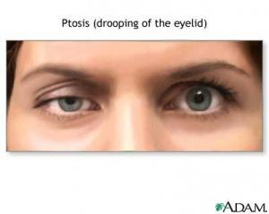
Myasthenia Gravis:
  Autoimmune disorder, in which antibodies destroy Ach receptors
  Because of safety factor, transmission at NMJ does not fail until many antibodies have accumulated
  EPPs not large enough to stimulate a.p. in muscle (Ineffective); Muscle fatigue ensues.
  Chewing, talking, swallowing, facial expressions affected; Breathing could be affected too.
  Death may result from paralysis of respiratory muscles (extreme situations)
  Treatment:
    Give inhibitors of Ach-ase (e.g. neostigmine)
    Steroids, Plasmapheresis technique

Slide 46
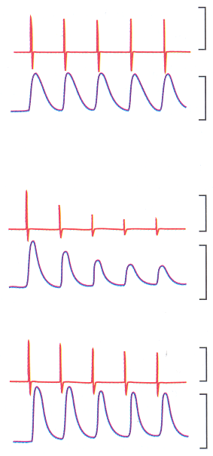
Muscle firing and Tension in response to nerve stimulation
10 mV
Normal
Muscle firing
Tension
10 kg
Untreated
Myasthenia
gravis
Treated
(neostigmine)

Slide 47
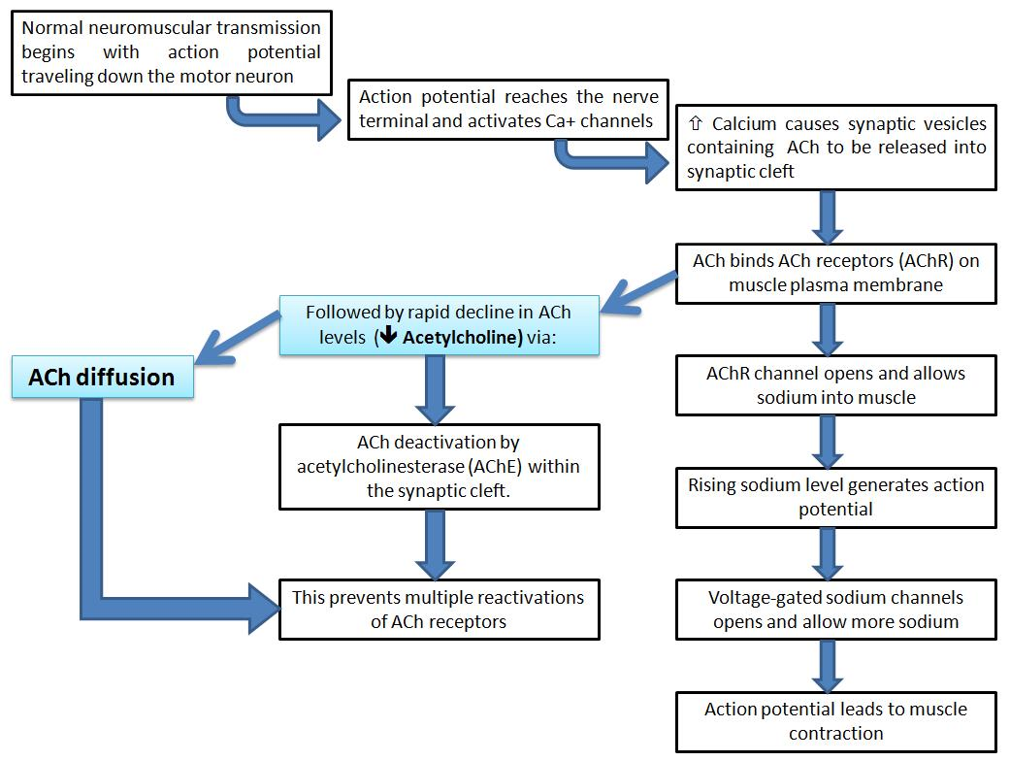
Events in N-M Transmission: A Summary

Slide 48
Important Terminologies :
Neuromuscular junction (NMJ): A specialised synapse where a motor neuron communicates with a skeletal muscle fibre. It has a presynaptic nerve terminal, synaptic cleft and postsynaptic muscle membrane. Motor unit: A single motor neuron and all the muscle fibres it innervates. Small motor units allow precise movements, while larger motor units are associated with stronger, less precise movements. Synaptic cleft: The small gap between the motor neuron terminal and the muscle membrane. Acetylcholine (ACh) is released into this space and diffuses across it. Acetylcholine (ACh): The neurotransmitter released by the motor neuron at the NMJ. It binds to receptors on the muscle membrane and initiates the electrical response. Nicotinic ACh receptor: A ligand-gated ion channel on the postsynaptic muscle membrane. Binding of ACh opens the channel, allowing mainly Na⁺ to enter and producing depolarisation. End-plate potential (EPP): The depolarisation of the muscle membrane at the motor end plate produced when ACh activates its receptors. The EPP then triggers an action potential in the nearby muscle membrane. Miniature end-plate potential (mEPP): A very small, spontaneous depolarisation of the muscle end plate produced by the release of ACh from a single synaptic vesicle. Quantal transmission: Neurotransmitter is released in discrete packets (quanta). At the NMJ, one quantum corresponds approximately to the contents of one ACh-containing vesicle.

Slide 49
Join the Vevox session
Go to vevox.app
Enter the session ID: 149-856-345
Or scan the QR code

Slide 50

Lets have some questions to solve after the session

